Slide 1

Health Tracker
“Democratizing Healthcare for every person”

Slide 2
Team 18
Chrysovergis Ilias, Department of Telecommunications
Hadjithoma Andreas, Department of Electronics & Computers
Megalou Spiridon, Department of Telecommunications
Niras Dimitrios, Department of Electronics & Computers

Slide 3
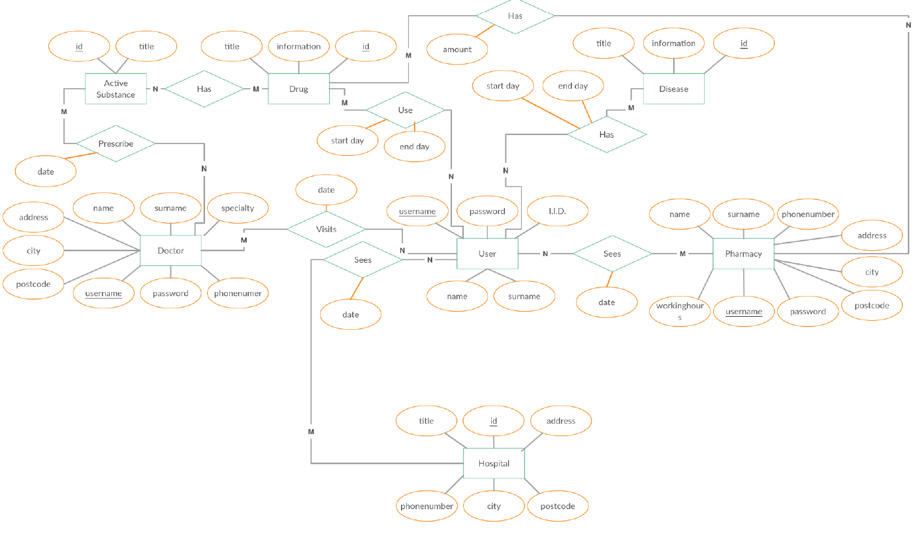
ER Diagram

Slide 4
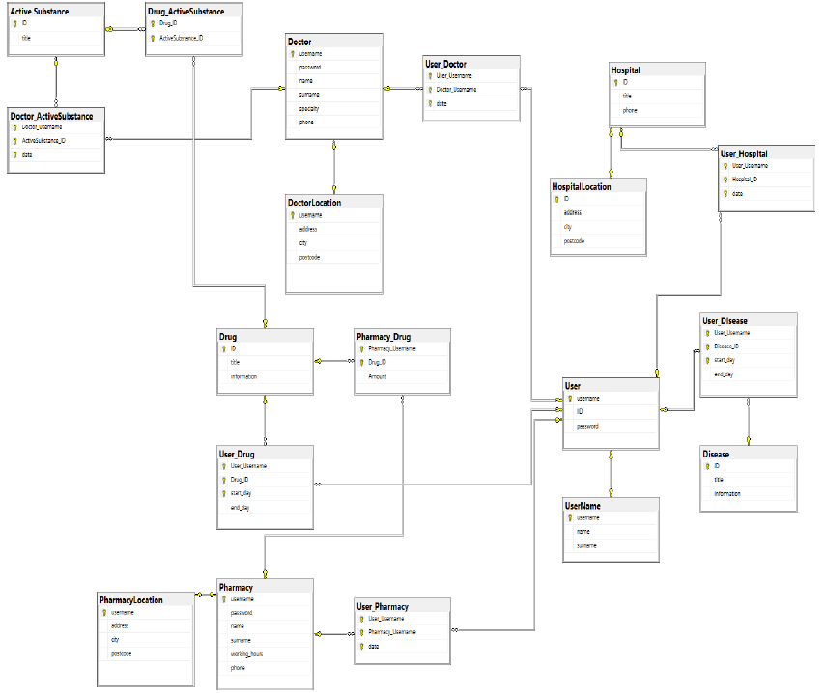
Relational Model

Slide 5
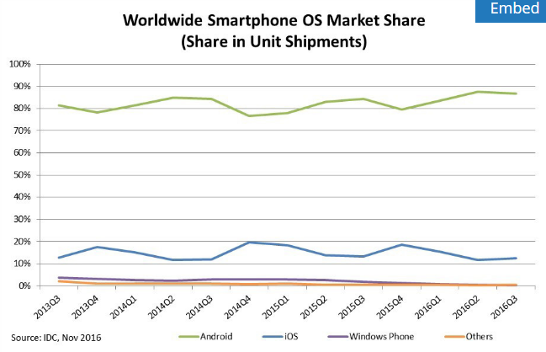
Mobile Application (Android)

Slide 6
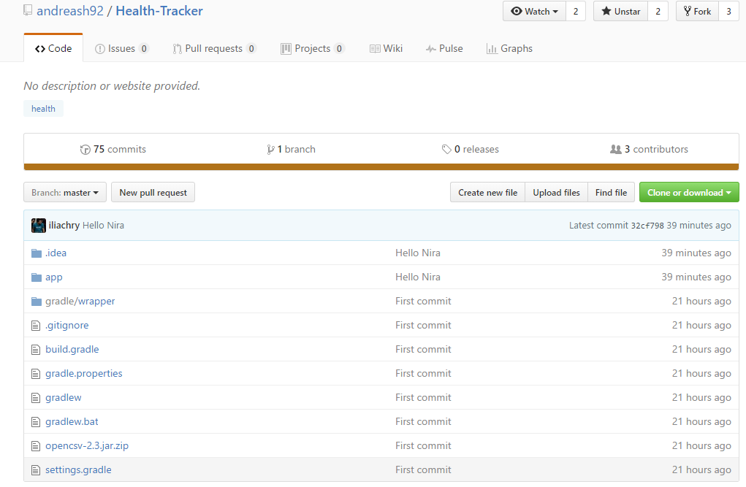
Open Source Project Github

Slide 7
Application Users
User
Doctor
Pharmacy
Admin

Slide 8
Database
Local Database
Communication with JSON requests
Future Work: Implement the database into the cloud

Slide 9
Live Demo

Slide 10
Thank you very much!
Any Questions ?

